Slide 1
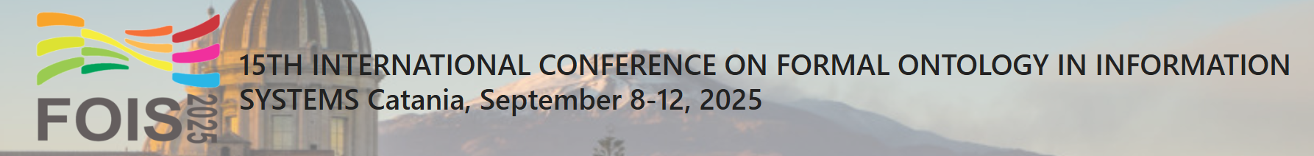



The Soberana Ontology
Modeling Business Ecosystems for International Data Spaces
Semantics, Cybersecurity, and Services
https://www.linkedin.com/company/scs-utwente/
Manoel Cunha; Patrício Silva; João Luiz Rebelo Moreira; and Glenda Amaral

Slide 2
Summary
In this presentation
Introduction: International Data Spaces, their problems and proposed solution;
Research Methodologies: Design Science & SABiO & OntoUML;
Ontology Design: Conceptual models;
Ontology Validation: Verification and Usage Demonstration;
Related Work: Comparison between existing solutions;
Conclusion: Lessons learned, limitations and future work.

Slide 3
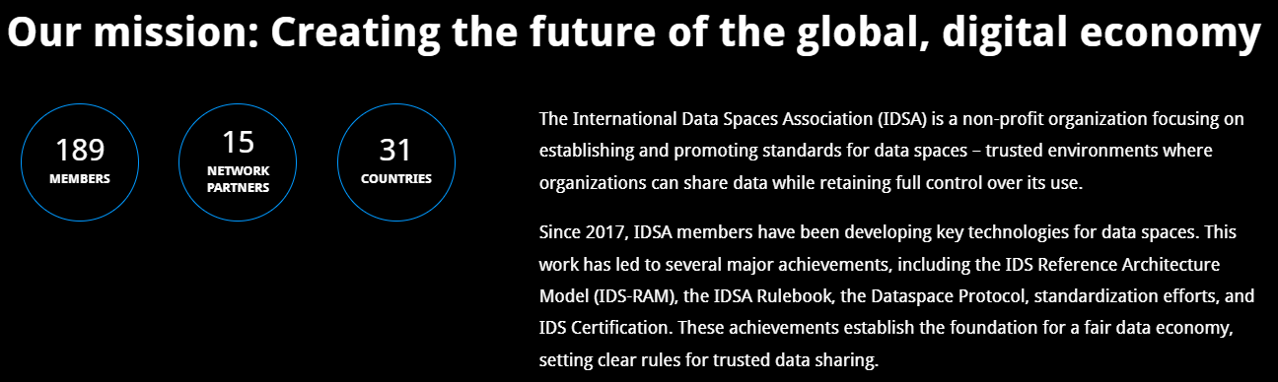

Introduction
Data Exchange and International Data Spaces (IDS)
Data is a key driver of value creation (data economy estimated at €550 Billions [1]);
Need for inter-organizational data sharing to form collaborative data ecosystems [2];
Concern: competitive risk and loss of control of their data leads to Data Sovereignty concept [3];
IDSA Initiative (2015): IDS Reference Architecture Model (IDS-RAM) for sovereign data sharing.

Slide 4
IDS-RAM. Author: IDSA

Slide 5
Introduction
Challenges and General Research Question
Challenges:
Design, governance, openness, and funding remain open issues [2];
Network effects: need to attract more data providers [2];
Lack of clear business models in IDS: stakeholders struggle to understand relationships and value proposition [4];
Research Question: how to formalize business models for data-sharing agreements in IDS?
Proposed Solution: ontology modeling since it structures a shared vocabulary among stakeholders, it is machine-processable enabling reasoning in large-scale data ecosystems, it is modular and scalable.

Slide 6
Research Methodologies
Design Science Research Methodology
Focus: design and investigation of artifacts in context. The interaction between artifacts and context may lead to a solution [5].
General Research Question can be divided into:
Conceptual Question (CQ): How do data-sharing agreements form in IDS?
Technical Question (TQ): How can a formal representation of business models for data-sharing agreements in IDS be designed and implemented?
Practical Question (PQ): Can business models of data-sharing agreements in IDS help organizations decide about entering or investing in it?

Slide 7
Research Methodologies
Methods for Answering Research Questions
CQ
Literature Review
IDS RAM & business models
TQ
Conceptual Modeling
Ontology Engeering (SABiO)
PQ
Usage Demonstration
Modeling IDS ecosystems
(CQ): How do data-sharing agreements form in IDS?
(TQ): How can a formal representation of business models for data-sharing agreements in IDS be designed and implemented?
(PQ): Can business models of data-sharing agreements in IDS help organizations decide about entering or investing in it?

Slide 8
Research Methodologies
Ontology Development with SABiO
Systematic Approach for Building Ontologies (SABiO) [6]
Tailored for domain ontologies;
Support reference ontologies (conceptual models, e.g., OntoUML) and operational ontologies (machine-interpretable, e.g., OWL);
Process steps:
Identify purpose and requirements: leading to competency questions;
Capture and Formalization: leading to conceptual model using OntoUML;
Design: from conceptual to operational;
Implementation; Testing and validation: usage demonstration and competency question queries

Slide 9
Research Methodologies
Why OntoUML?
Based on UFO (Unified Foundational Ontology): ensures semantic precision;
Key stereotypes for modeling: Kind (functional complex), Role (captures mutable characteristics an entity can assume), Relator (relates two or more entities), Category (aggregates properties shared by individuals), Mode (intrinsic aspect), etc;
Advantages: Grounded in strong ontological theory; facilitates early validation with stakeholders; supports syntactic verification via modeling tools; Improves expressiveness and conceptual rigor;
Recommend by SABiO.

Slide 10
Ontology Design
Simplified Ontology Requirements Specification Document
Objective and Implementation Language: Present a basic conceptual model of the IDS domain and provide the user with a view of the data sovereignty aspects, legitimacy of participants, and the economic agreement for data exchange within these spaces. With the ontology, it should be possible to instantiate IDS organizational models according to the IDS RAM parameters, as well as retrieve information for the analysis of the models in the three mentioned aspects. The reference ontology should be implemented in OntoUML, serialized in Turtle, and operationalized in OWL.
Competence Questions Group: • CQ1. Who are the sovereign owners of their data? • CQ2. Who are the legitimate participants in the IDS? • CQ3. What are the data offers made of? • CQ4. Who is participating in economic agreements for data sharing?

Slide 11
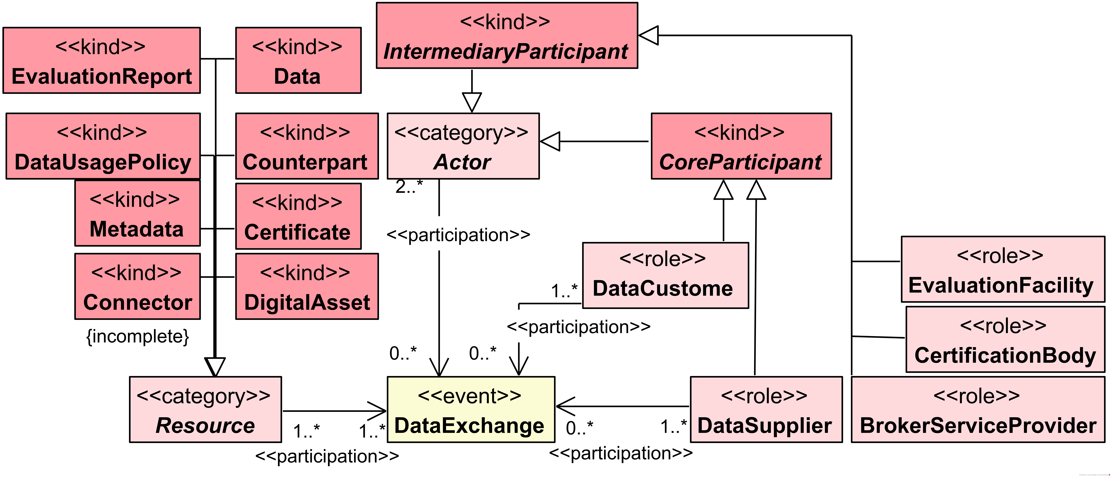
Soberana Ontology
Core View
CQ1. Who are the sovereign owners of their data?
CQ2. Who are the legitimate participants in the IDS?
CQ3. What are the data offers made of?
CQ4. Who is participating in economic agreements for data sharing?

Slide 12
Soberana Ontology
Data Sovereignty View
CQ1. Who are the sovereign owners of their data?
CQ2. Who are the legitimate participants in the IDS?
CQ3. What are the data offers made of?
CQ4. Who is participating in economic agreements for data sharing?

Slide 13
Soberana Ontology
Legitimacy View
CQ1. Who are the sovereign owners of their data?
CQ2. Who are the legitimate participants in the IDS?
CQ3. What are the data offers made of?
CQ4. Who is participating in economic agreements for data sharing?

Slide 14

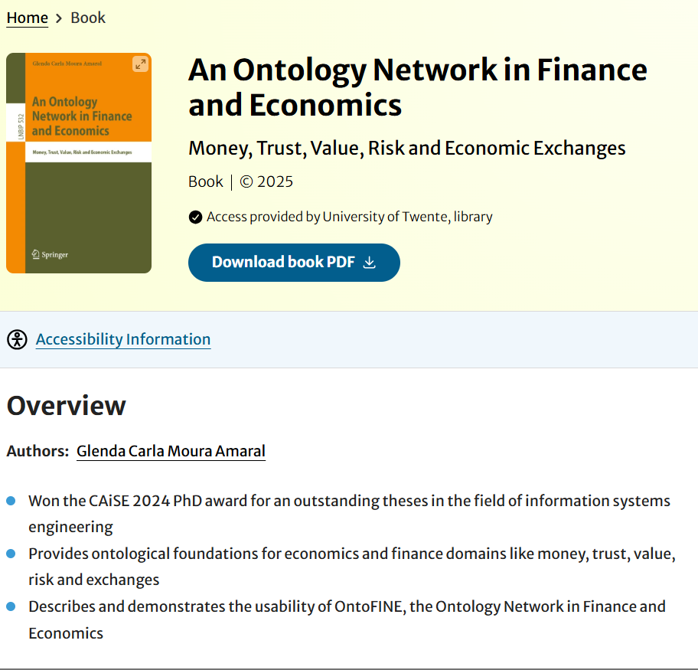
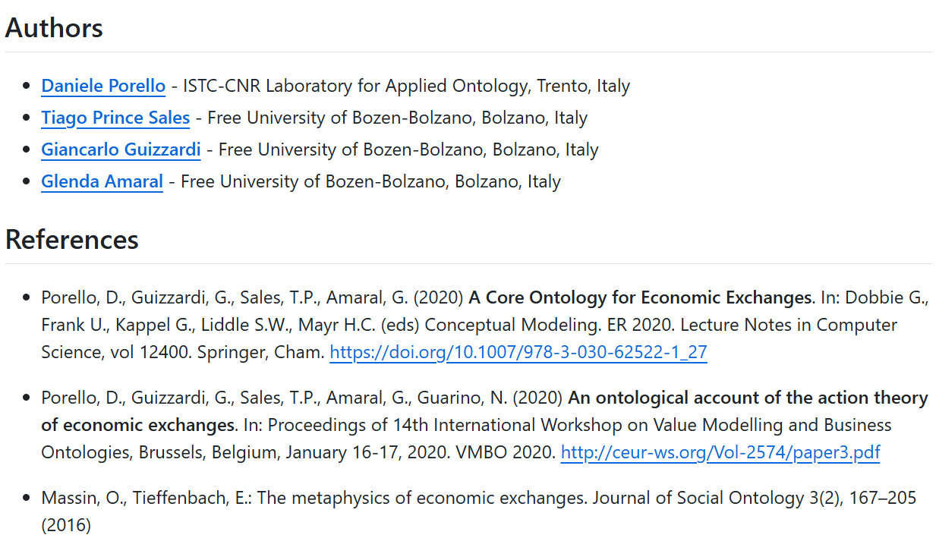
Soberana Ontology
CQ1. Who are the sovereign owners of their data?
CQ2. Who are the legitimate participants in the IDS?
CQ3. What are the data offers made of?
CQ4. Who is participating in economic agreements for data sharing?
Ontology Reuse!
COEX: Core Ontology for Economic Exchanges
https://github.com/unibz-core/economic-exchanges-ontology
https://link.springer.com/book/10.1007/978-3-031-71082-7
Notes:
The offer and economic agreement perspectives in data exchange events reuse concepts
from the Core Ontology for Economic Exchanges (COEX) proposed by Porello et
al. [13]. This ontology models exchanges as agreements based on the actions that economic
agents commit to performing. Consequently, data exchanges, from an economic
standpoint, are classified as economic exchanges. Due to its OntoUML-based structure,
this ontology is fully interoperable with Soberana.
[13] Porello D, et al. A core ontology for economic exchanges. In: International Conference on Conceptual
Modeling. Springer International Publishing; 2020. p. 364-74.

Slide 15
Soberana Ontology
Data Offering View
CQ1. Who are the sovereign owners of their data?
CQ2. Who are the legitimate participants in the IDS?
CQ3. What are the data offers made of?
CQ4. Who is participating in economic agreements for data sharing?
Notes:
The offer and economic agreement perspectives in data exchange events reuse concepts
from the Core Ontology for Economic Exchanges (COEX) proposed by Porello et
al. [13]. This ontology models exchanges as agreements based on the actions that economic
agents commit to performing. Consequently, data exchanges, from an economic
standpoint, are classified as economic exchanges. Due to its OntoUML-based structure,
this ontology is fully interoperable with Soberana.
[13] Porello D, et al. A core ontology for economic exchanges. In: International Conference on Conceptual
Modeling. Springer International Publishing; 2020. p. 364-74.

Slide 16
Soberana Ontology
Economic Agreement View
CQ1. Who are the sovereign owners of their data?
CQ2. Who are the legitimate participants in the IDS?
CQ3. What are the data offers made of?
CQ4. Who is participating in economic agreements for data sharing?

Slide 17
Ontology Validation
Operationalization and Verification
Reference ontology (Onto UML) serialized in Turtle (using the OntoUML plugin) and refined in Protégé. After, exported as OWL/XML.
Verification follows the criteria defined by [7]: Correctness, Completeness and Consistency:
HermiT reasoner (in Protégé) was used for logical consistency;
Correctness and Completeness were verified through competence questions formalized using SPARQL queries (available on GitHub repo).

Slide 18
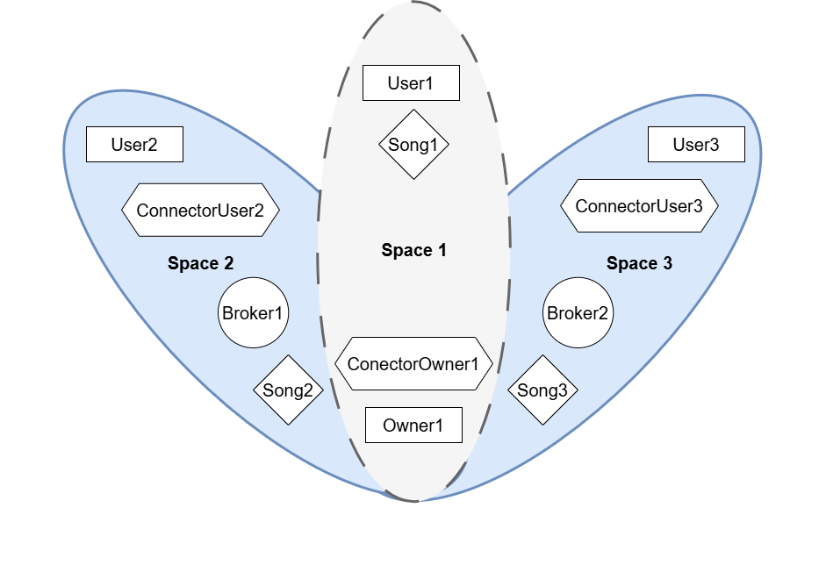
Ontology Validation
Usage Demonstration
Synthetic dataset created to simulate IDS data-sharing scenarios.
Inspired by:
Otto’s classification of ecosystems stages (Closed, Open, Federated) [2];
Music Rights Clearance case [8].

Slide 19
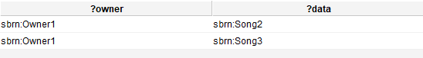
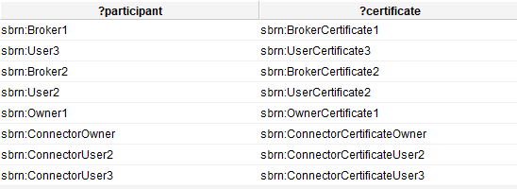
Ontology Validation
SPARQL queries results
CQ1: Who are the sovereign owners of their data?
CQ2: Who are the legitimate participants in the IDS?

Slide 20
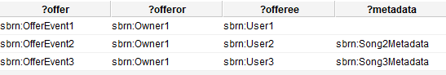
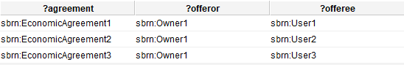
Ontology Validation
SPARQL queries results
CQ3: What are the data offers made of?
CQ4: Who participates in economic sharing agreements?

Slide 21
Related Work
Similar approaches
Work | Description | Soberana Complements by…
Krotova et al. [9] | Economic analysis of open data sharing in Europe; They have found that data disclosure is driven by economic motivation and clear agreements; No ontology. | Formalizing these conditions into ontology-driven business models.
Bader et al. [10] | Umbrella ontology for IDS (focus: technical and pragmatic); Reuses existing standards and offers a solid technical vocabulary; Covers roles, connectors, certification, policies; Lacks organizational and economic modeling of agreements. | Adding semantic expressiveness through UFO and SABiO methodology for roles, commitments, and agreement dynamics.
Gort [11] | Maturity model for IDS adoption; Evaluates maturity levels, costs, adoption paths; Focuses on a single company, not the ecosystems. | Providing a business modeling perspective; Captures economic interactions across multiple participants.
Notes:
while Bader’s model reuses existing standards and offers a solid technical vocabulary,
Soberana adopts the UFO ontology and SABiO methodology, providing greater semantic
expressiveness to capture roles, commitments, and agreement phases in complex
socio-technical ecosystems.

Slide 22


Conclusion
Contribution: Soberana ontology models data-sharing agreements in IDS; and provides a structured, semantic framework for secure and sovereign data exchange.
Research Questions:
How do data-sharing agreements occur in IDS? Answered via literature review;
How to model these agreements? With Soberana ontology;
Are these models useful? Partially shown via synthetic dataset.
Limitations: Validation only with synthetic data and tools inconsistencies founded (like OntoUML plugin gaps and unclear stereotypes);
Future Work: A real world case study validation; Graphical tool for ontology management; Expansion with new concepts and other ontologies; Refinement via expert input.

Slide 23
References
[1] European Commission . The European Data Market Monitoring Tool: Key Facts & Figures, First Policy Conclusions, Data Landscape and Quantified Stories. Directorate General for Communications Networks, Content and Technology; 2020.
[2] Otto B. The Evolution of Data Spaces. In: Otto B, Hompel Mt, Wrobel S, editors. Designing Data Spaces: The Ecosystem Approach to Competitive Advantage. Springer; 2022. p. 3-16.
[3] Jarke M, Otto B, Ram S. Data Sovereignty and Data Space Ecosystems. Business & Information Systems Engineering. 2019;61:549-50.
[4] Nagel L, Lycklama D. How to Build, Run, and Govern Data Spaces. In: Otto B, Hompel Mt, Wrobel S, editors. Designing Data Spaces: The Ecosystem Approach to Competitive Advantage. Springer; 2022. p. 17-28.
[5] Wieringa R. Design science methodology for information systems and software engineering. Springer; 2014.
[6] Falbo RA. SABiO: Systematic Approach for Building Ontologies. In: Onto.Com/ODISE@FOIS. vol. 1301; 2014.
[7] Suárez-Figueroa MC, G´omez-P´erez A, Villaz´on-Terrazas B. How to write and use the ontology requirements specification document. In: On the Move to Meaningful Internet Systems: OTM 2009. Springer Berlin Heidelberg; 2009. p. 966-82.
[8] Pedrinaci C, et al. Music Rights Clearance Business Analysis and Delivery. In: E-Commerce and Web Technologies; 2005. p. 198-207
[9] Krotova A, Mertens A, Scheufen M. Open Data and Data Sharing: An Economic Analysis. IW-Policy Paper; 2020.
[10] Bader S, et al. The international data spaces information model–an ontology for sovereign exchange of digital content. In: International Semantic Web Conference. Cham: Springer International Publishing; 2020. p. 176-92.
[11] Gort E. Developing a Maturity Model Based Approach Supporting the Decision to Adopt International Data Spaces. University of Twente; 2021.

Slide 24
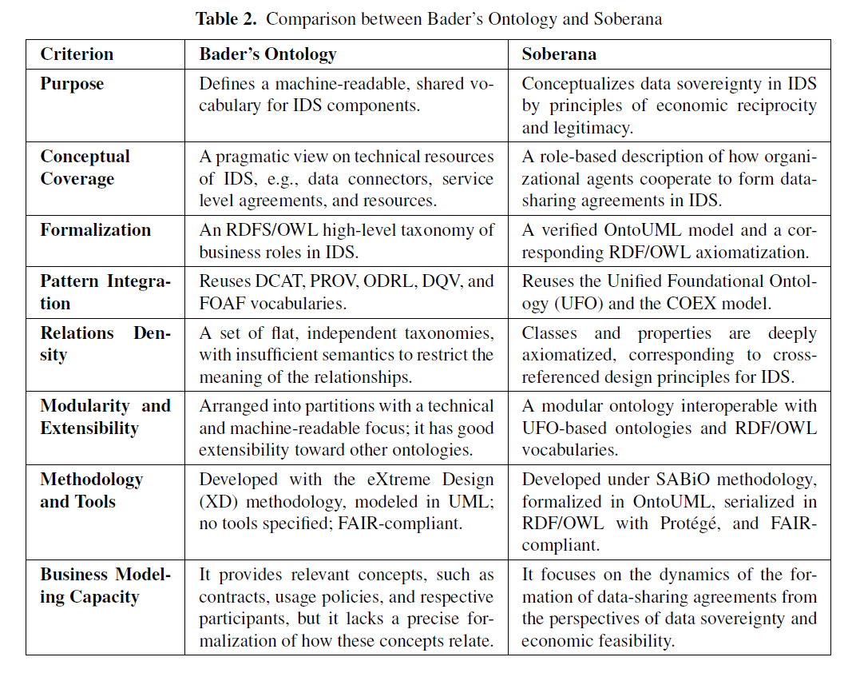
Related Work
Similar approaches
Notes:
while Bader’s model reuses existing standards and offers a solid technical vocabulary,
Soberana adopts the UFO ontology and SABiO methodology, providing greater semantic
expressiveness to capture roles, commitments, and agreement phases in complex
socio-technical ecosystems.

